Slide 1
Big Data
Final Presentation Group 23
Github Repository: https://github.com/Zankar100/BigDataGroup23
PRESENTED BY: Bansi Shah (bks7385), Zankar Murudkar (zm2117), Tirth Patel (tmp9936)
DATE: 12/13/2021

Slide 2
Agenda
Tools used for Profiling and Cleaning
Dataset
Data Issues and Methods to Clean them
Challenges

Slide 3



Tools Used for Profiling and Cleaning

Slide 4
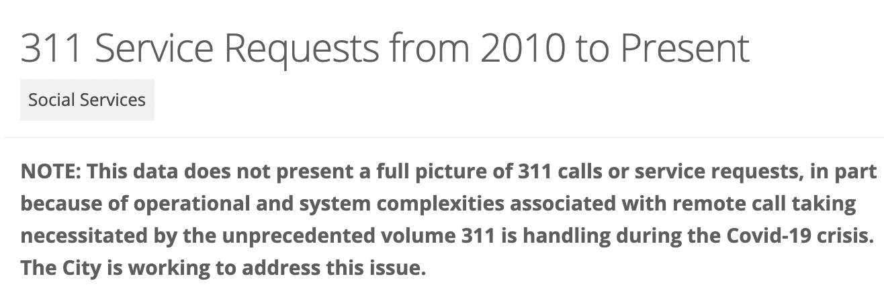
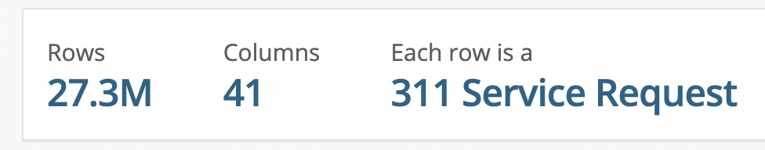
Dataset
https://data.cityofnewyork.us/Social-Services/311-Service-Requests-from-2010-to-Present/erm2-nwe9

Slide 5
Data Issues and Methods to Clean them

Slide 6
Null Values Count
Unique_Key=0.0,
Created_Date=0.0,
Closed_Date=0.04949,
Agency=0.0,
Agency_Name=0.0,
Complaint_Type=0.0,
Descriptor=0.0032593333333333333,
Location_Type=0.305324,
Incident_Zip=0.3192426666666667,
Incident_Address=0.34485266666666664,
Street_Name=0.34491133333333335,
Cross_Street_1=0.5335506666666666,
Cross_Street_2=0.54303,
Intersection_Street_1=0.6206986666666666,
Intersection_Street_2=0.6230033333333334,
Address_Type=0.52,
City=0.3392153333333333,
Landmark=0.762316,
Facility_Type=0.44323,
Status=0.0, Due_Date=0.682708,
Resolution_Description=0.024336,
Resolution_Action_Updated_Date=0.05073866666666667
Community_Board=0.012646,
BBL=0.5459406666666666,
Borough=0.012646,
X Coordinate (State Plane)=0.47851666666666665,
Y Coordinate (State Plane)=0.47848066666666667,
Open Data Channel Type=1.2666666666666667e-05,
Park Facility Name=1.2666666666666667e-05, Park_Borough=0.012646,
Vehicle Type=0.9994933333333333,
Taxi Company Borough=0.9989966666666666,
Taxi Pick Up Location=0.9869713333333333,
Bridge Highway Name=0.9947166666666667,
Bridge Highway Direction=0.9948233333333333,
Road Ramp=0.9948666666666667,
Bridge Highway Segment=0.9946873333333334, Latitude=0.47852466666666665, Longitude=0.47852466666666665, Location=0.47851266666666664)

Slide 7
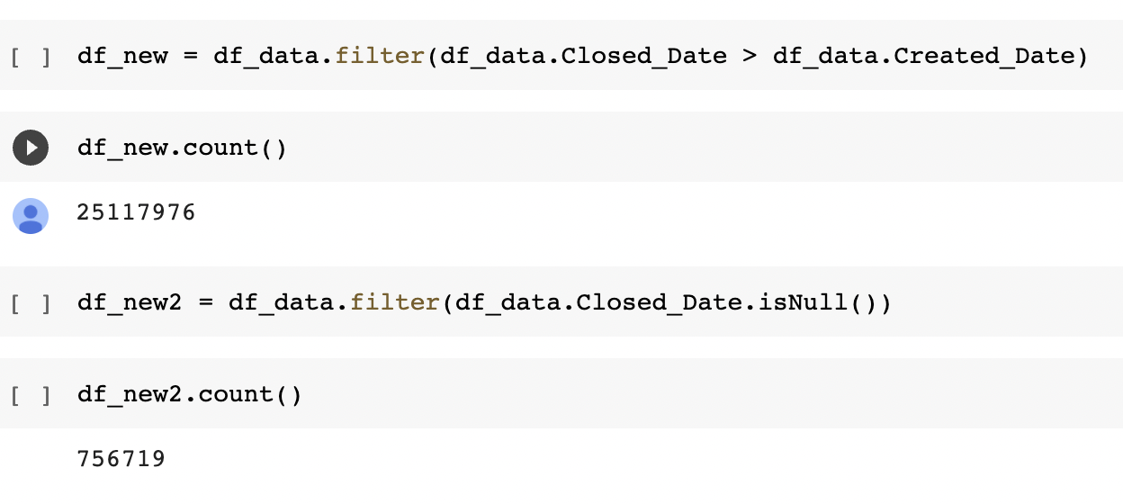
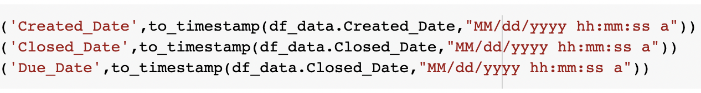
Column Dependency (Dates)
We have 2 columns ‘Created Date’ and ‘Closed Date’.
For the data to be valid, ‘Closed Date’ must be greater than ‘Created Date’
We first convert these columns from string type to timestamp and then compare them to deem valid or invalid ‘Closed Date’.
The rows with ‘Closed Date’ earlier than ‘Open Date’ are invalid and hence removed from the data.

Slide 8
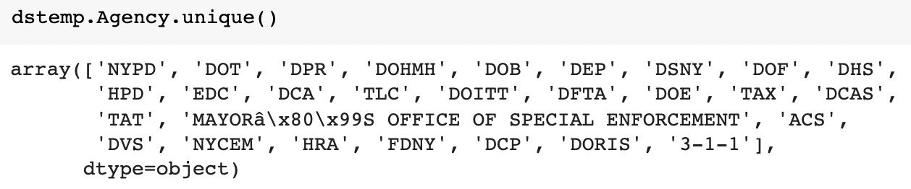
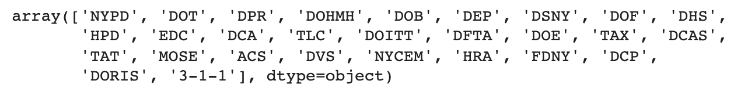
Abbreviate Agency Name
Takes in an agency name and converts to abbreviated form, if the agency is the Office of Special Enforcement

Slide 9
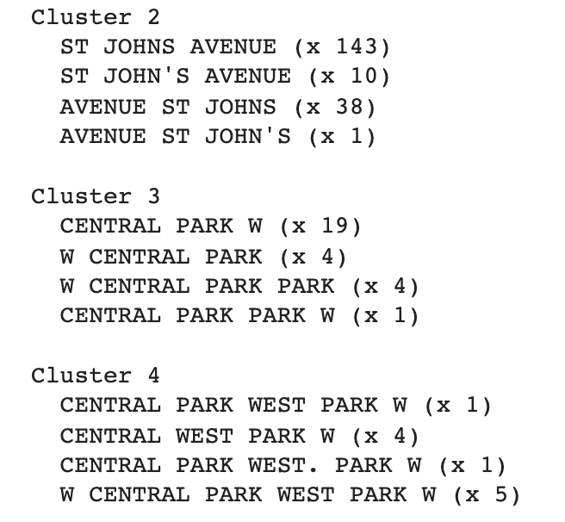
Street Name Misspelled
After clustering we found that some street names were misspelled.
We can replace the street names to solve this issue

Slide 10
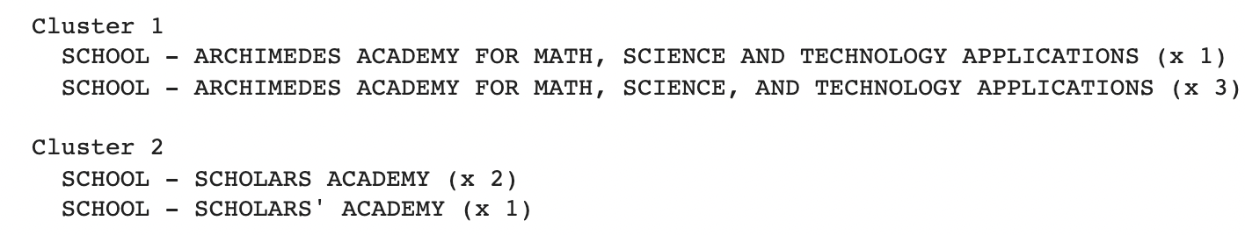
Agency Name Misspelled

Slide 11
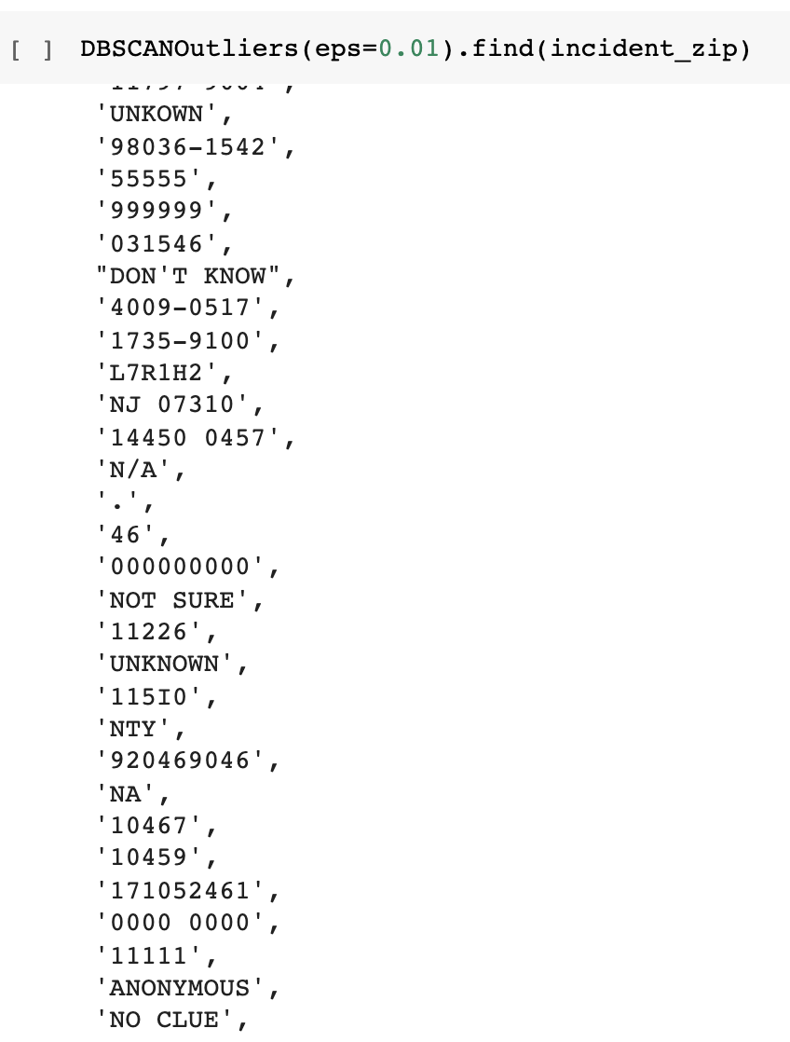
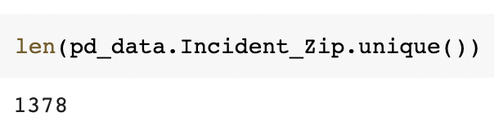
Zip Code - Out of Range
We used reference data to check which zip codes
are invalid and marked them as ‘unspecified’.
Total unique zip codes in our data

Slide 12
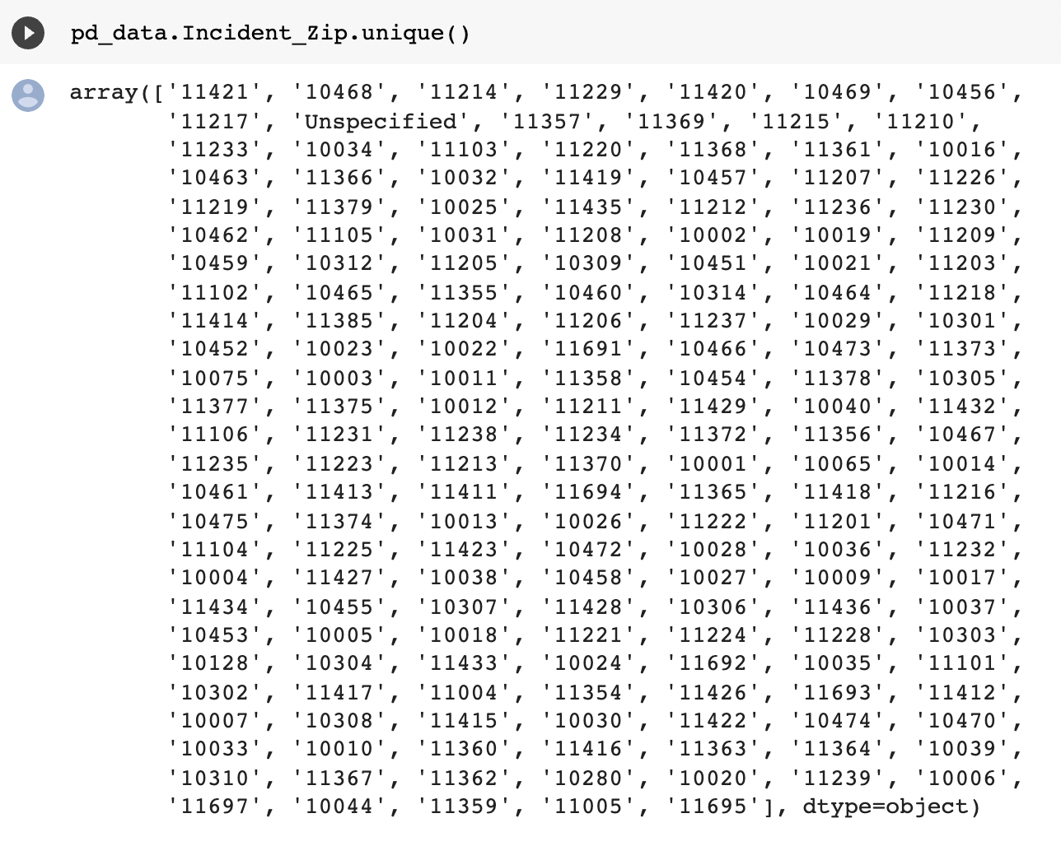
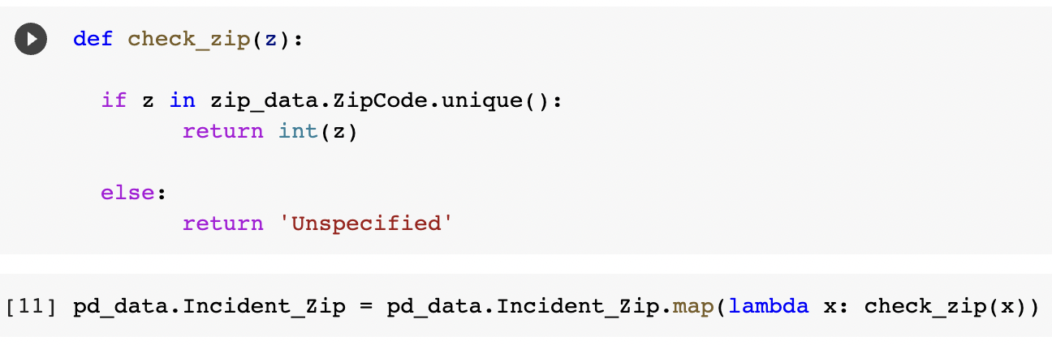

Slide 13
Mapping Zip Code to Borough
After validating all the zip codes, we check if the specified zip code value actually belongs to the specified borough or not.
We used reference data for this and compared its (borough, zip code) pair to the (borough, zip code) pair in our data.
If the data did not match then we replaced the borough that matches the given zip code.

Slide 14
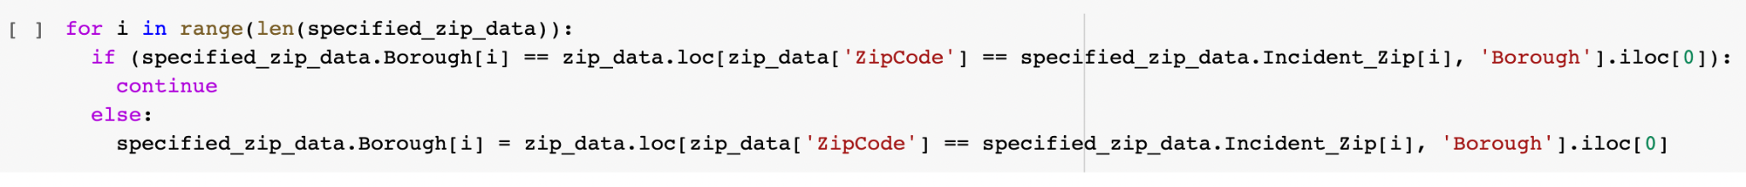
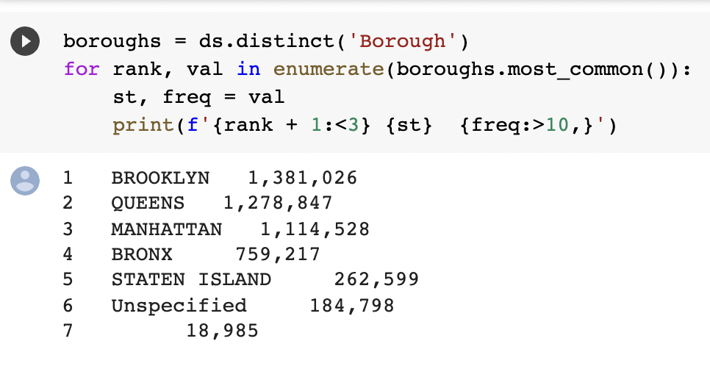
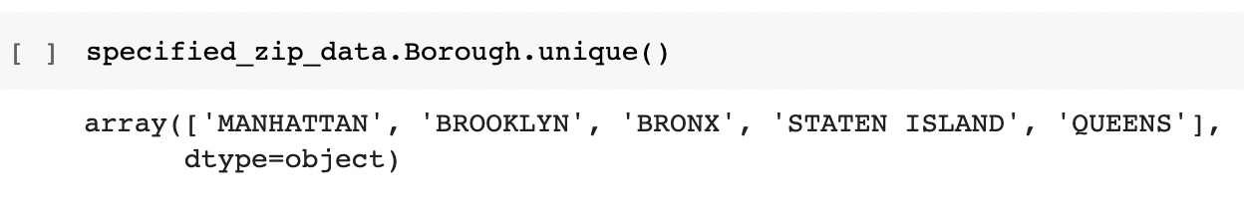

Slide 15
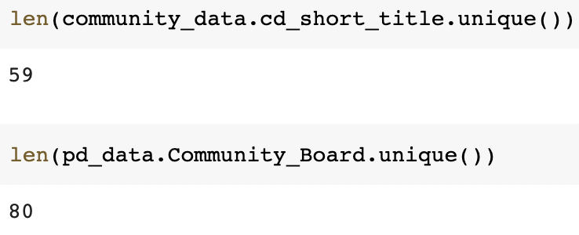
Community Board - Out of Range
We used reference data to check which values in our data column are invalid and termed them as ‘unspecified’.
Total no. of valid Community Boards
Total no. of unique Community Boards found in our data.

Slide 16
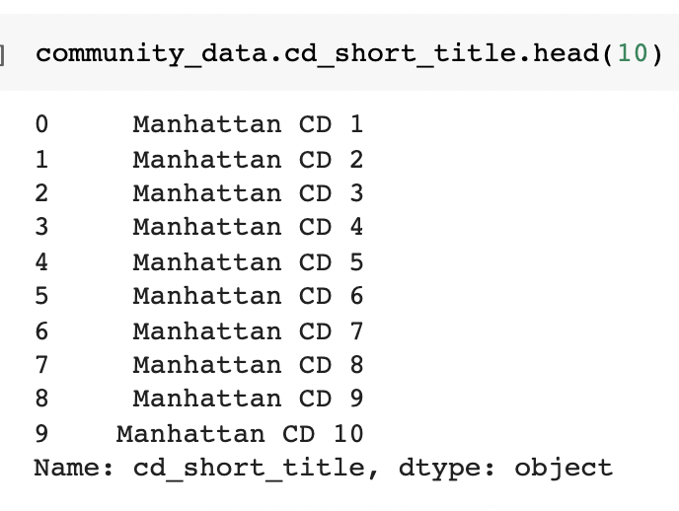
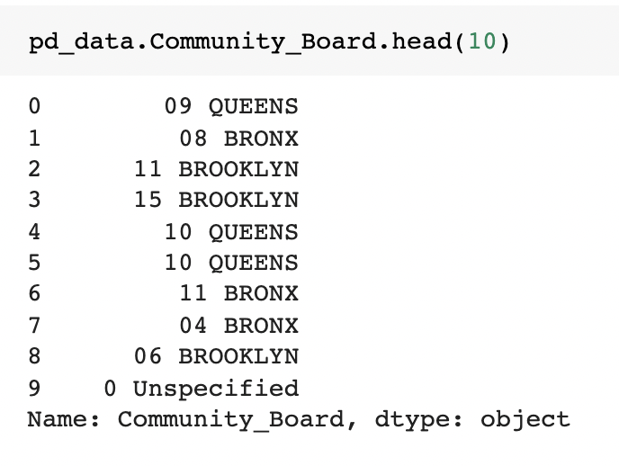
Cont.
Difference in Reference data and dataset

Slide 17
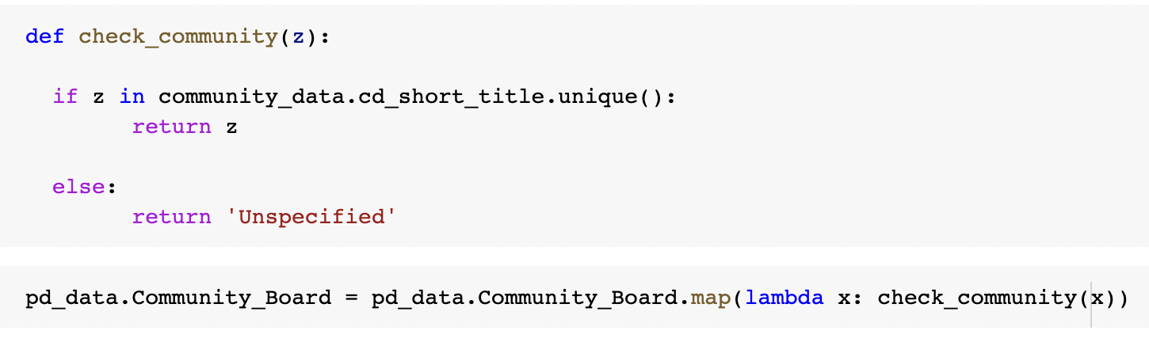
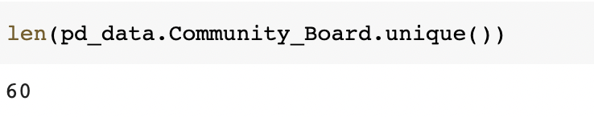
Range check on Community Board
Total no. of unique community board values in the data after cleaning.

Slide 18
Data cleaning on Datasets with Overlapping Columns
DYCD after-school programs: Immigrant Services | https://data.cityofnewyork.us/Social-Services/DYCD-after-school-programs-Immigrant-Services/zmut-au2w
Board of Standards and Appeals | https://data.cityofnewyork.us/w/yvxd-uipr/25te-f2tw?cur=AbBzeB8m2eb&from=root
3K Projects by Site Locations | https://data.cityofnewyork.us/Education/3K-Projects-by-Site-Locations/yv4m-nu6d
Fire Incident Dispatch Data | https://data.cityofnewyork.us/Public-Safety/Fire-Incident-Dispatch-Data/8m42-w767
Jobs Created by Energy Cost Savings Program Savings for Businesses - FY2020 | https://data.cityofnewyork.us/City-Government/Jobs-Created-by-Energy-Cost-Savings-Program-Saving/yqky-aebb

Slide 19
Thank you!

